Slide 1
PAPER REVIEW
Learning Phrase Representations using
RNN Encoder–Decoder for Statistical
Machine Translation
Cho, van Merriënboer, Gulcehre, Bahdanau, Bougares, Schwenk & Bengio — EMNLP 2014

Slide 2
01 · PROBLEM
Problem Statement
Fixed statistical framework
No true variable-length modeling
Need: a learned scoring model
Phrase-based SMT scores phrase pairs using frequency counts from a fixed phrase table — brittle for rare or unseen phrases.
Existing neural approaches in SMT mostly needed fixed-size inputs/outputs, unsuited to sentences of varying length.
A model that can take a variable-length source phrase and produce a variable-length target phrase representation.
2 / 10

Slide 3
02 · MOTIVATION
Motivation
1
Phrase-based SMT limits
Traditional systems can't capture deep semantic/syntactic similarity between phrase pairs.
2
RNNs for sequences
Recurrent networks can compress a variable-length sequence into a fixed-length vector, and expand it back out.
3
A scoring signal, not full translation
Rather than replace SMT, use RNNs to add a smarter feature that re-scores existing phrase pairs.
3 / 10

Slide 4
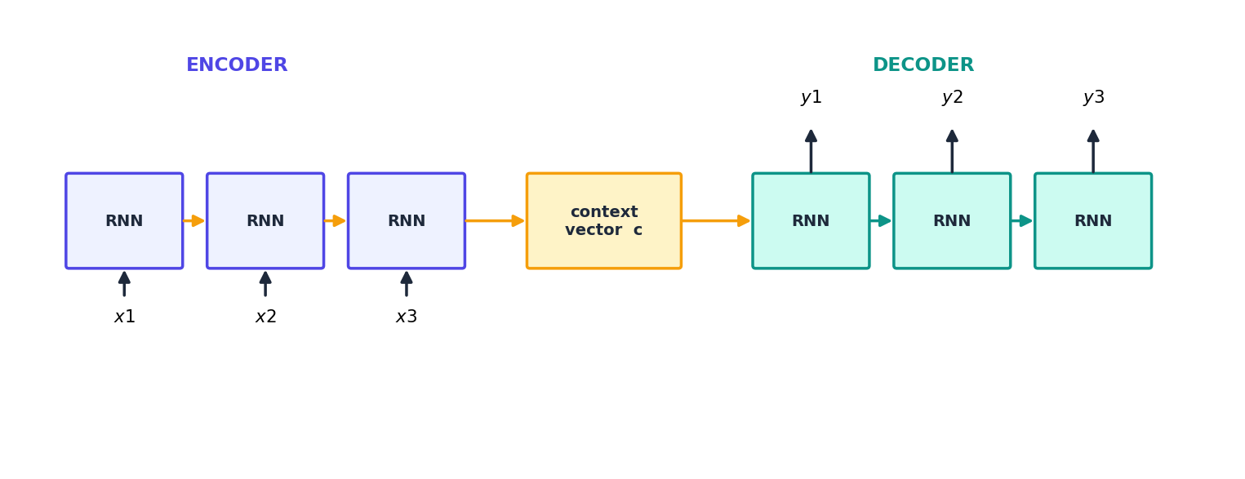
03 · FRAMEWORK
Encoder–Decoder Framework
Encoder: reads the source sequence, compresses it into a fixed-length context vector c. Decoder: generates the target sequence conditioned on c and its own previous outputs.
4 / 10

Slide 5
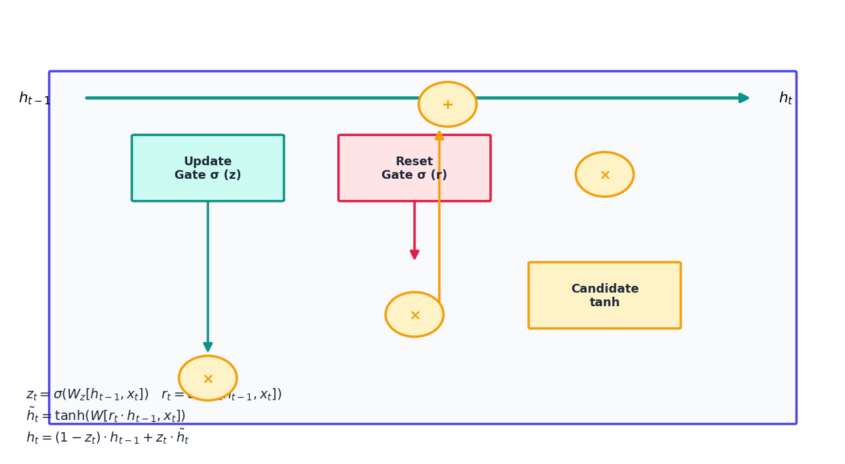
04 · ARCHITECTURE
Proposed Architecture — the GRU
To make the encoder/decoder trainable and effective, the authors proposed a new hidden unit — the Gated Recurrent Unit (GRU) — with two gates that control memory flow, avoiding the vanishing-gradient issues of a plain RNN.
Update gate z: how much old vs. new state to keep
Reset gate r: how much past to ignore for the candidate
No separate cell state: unlike LSTM — simpler, fewer parameters
5 / 10

Slide 6
05 · CONTRIBUTIONS
Key Contributions
Introduced the GRU
Novel RNN Encoder–Decoder model
A simpler, effective gated recurrent unit — now a standard building block alongside LSTM.
First to jointly train an encoder and decoder RNN to maximize conditional probability of target given source.
Phrase pair scoring as a feature
Meaningful learned representations
Used the trained model's conditional probabilities as an extra feature in a phrase-based SMT log-linear model.
Showed the model learns semantically & syntactically coherent phrase embeddings (visualized via clustering).
6 / 10

Slide 7
06 · RESULTS
Experimental Results
English → French, WMT'14 — BLEU scores (test set)
Configuration | Dev BLEU | Test BLEU
Baseline phrase-based SMT | 30.64 | 33.30
+ RNN Encoder–Decoder score | 31.20 | 33.87
+ CSLM + RNN | 31.48 | 34.64
+ CSLM + RNN + word penalty | 31.50 | 34.54
Takeaways
RNN score alone improves test BLEU from 33.30 → 33.87
Gains are complementary to a Continuous Space Language Model (CSLM)
Qualitative analysis: t-SNE shows phrase embeddings cluster by meaning & syntax
7 / 10

Slide 8
07 · CRITIQUE
Strengths & Limitations
Strengths
Limitations
Introduced GRU — simpler & cheaper than LSTM
Handles variable-length input/output naturally
Learns meaningful, reusable phrase representations
Fixed-length context vector bottlenecks long sentences
Not used for direct end-to-end translation, only re-scoring
Evaluated mainly on short phrase pairs, not full documents
8 / 10

Slide 9
08 · APPLICATIONS
Applications
Machine translation
Text summarization
Speech recognition
Chatbots & dialogue
Direct ancestor of modern NMT — encoder-decoder is the core of Google Translate-style systems.
Same framework compresses long input text into a fixed vector, then decodes a summary.
Encoder compresses audio features; decoder emits transcribed text sequences.
Sequence-to-sequence response generation builds directly on this framework.
9 / 10

Slide 10
Personal Insights
This paper's real legacy isn't the SMT re-scoring result — it's the GRU and the encoder-decoder pattern itself, which became the backbone of modern seq2seq models.
The fixed-length context vector is the paper's clearest weakness — it directly motivated attention mechanisms a year later.
A great example of how a modest empirical gain (33.30 → 34.64 BLEU) can still mark a major architectural turning point.
10 / 10

Slide 11
THANK YOU
10 / 10

